Slide 1
The Maximum Clique Problem
Alyssa I mean Angela I mean Alyssa Newman

Slide 2
Recall the problem
The Maximum Clique Problem is the problem of finding the maximum clique, or complete subgraph, of a graph.
The greedy algorithm starts with any vertex and iteratively adds any other vertex such that adding that vertex maintains the subgraph being a clique.
This problem is known to be NP-complete so there is no efficient algorithm.
3
1
2

Slide 3
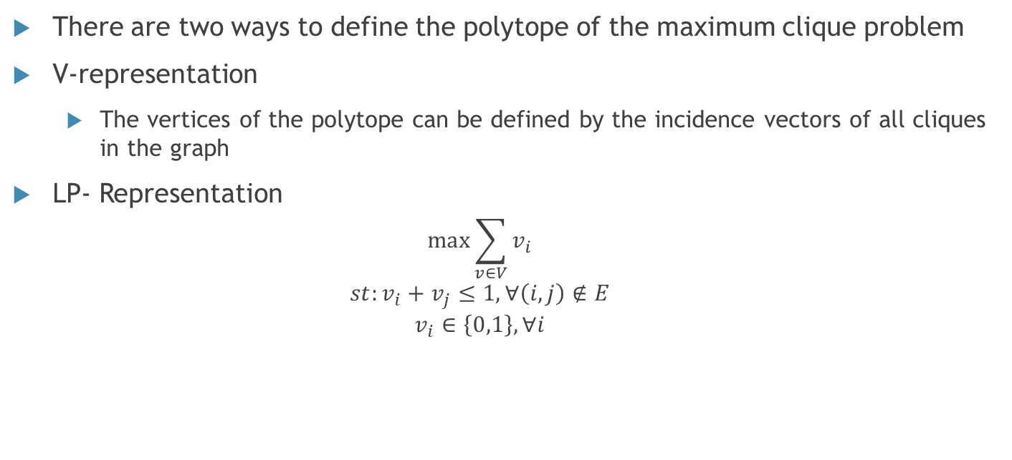
Polytope of the Maximum Clique
There are two ways to define the polytope of the maximum clique problem
V-representation
The vertices of the polytope can be defined by the incidence vectors of all cliques in the graph
LP- Representation
$$\max{\sum_{v∈V}{v_{i}}}$$
$$st:v_{i}+v_{j}≤1, ∀\left(i,j\right)∉E$$
$$v_{i}∈\left\{0,1\right\}, ∀i$$

Slide 4
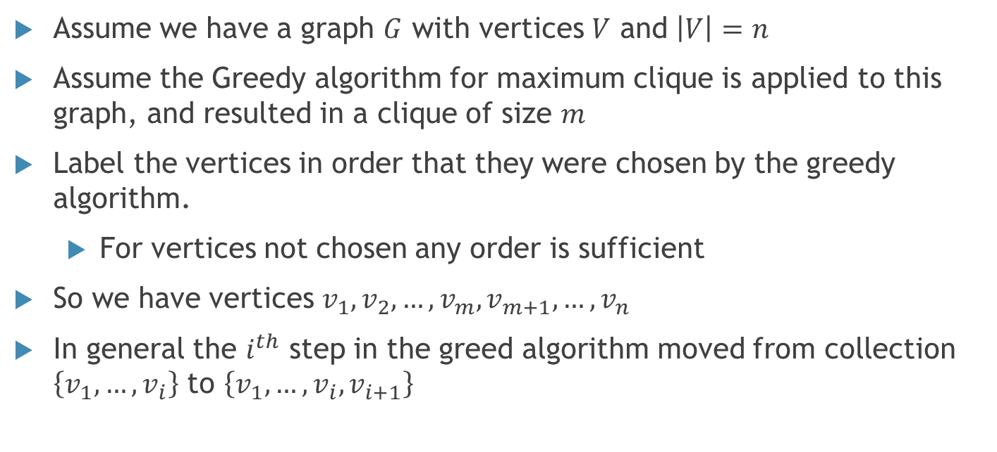
General Greedy on a Graph
Assume we have a graph $G$ with vertices $V$ and $\left|V\right|=n$
Assume the Greedy algorithm for maximum clique is applied to this graph, and resulted in a clique of size $m$
Label the vertices in order that they were chosen by the greedy algorithm.
For vertices not chosen any order is sufficient
So we have vertices $v_{1},v_{2},…,v_{m}, v_{m+1},…,v_{n}$
In general the $i^{th}$ step in the greed algorithm moved from collection $\left\{v_{1},…,v_{i}\right\}$ to $\left\{v_{1},…,v_{i},v_{i+1}\right\}$

Slide 5

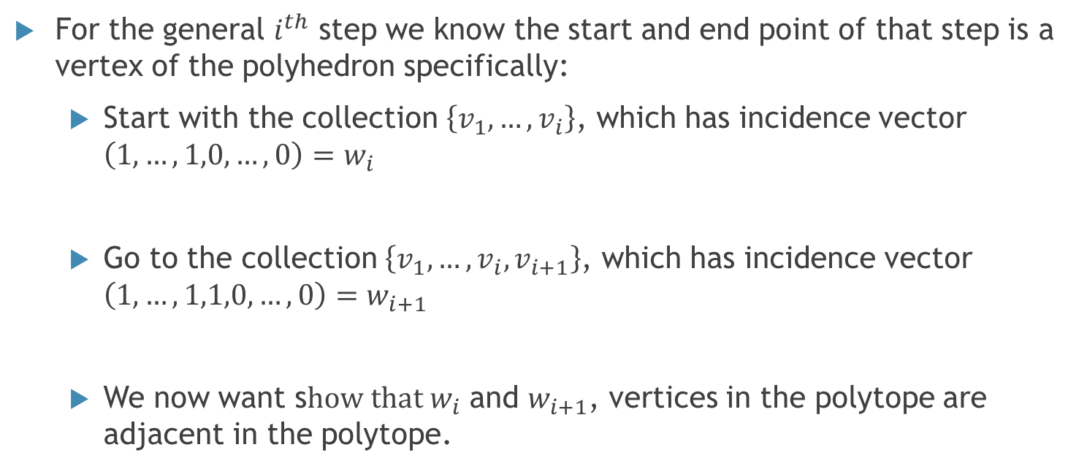



A closer look at a step in the greedy algorithm
For the general $i^{th}$ step we know the start and end point of that step is a vertex of the polyhedron specifically:
Start with the collection $\left\{v_{1},…,v_{i}\right\}$, which has incidence vector $\left(1,…,1,0,…,0\right)=w_{i}$
Go to the collection $\left\{v_{1},…,v_{i},v_{i+1}\right\}$, which has incidence vector $\left(1,…,1,1,0,…,0\right)=w_{i+1}$
We now want s$how that w_{i}$ and $w_{i+1}$, vertices in the polytope are adjacent in the polytope.
$$i$$
$$m−i$$
$$i+1$$
$$m−i−1$$

Slide 6
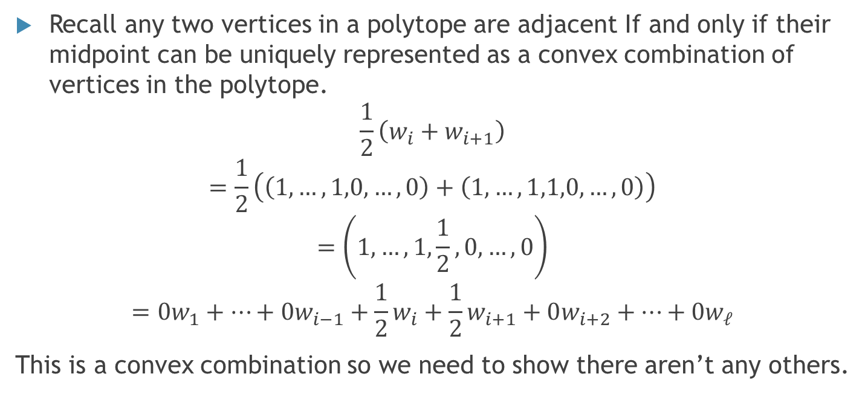
Determine if those two vertices are adjacent
Recall any two vertices in a polytope are adjacent If and only if their midpoint can be uniquely represented as a convex combination of vertices in the polytope.
$$\frac{1}{2}\left(w_{i}+w_{i+1}\right)$$
$$=\frac{1}{2}\left(\left(1,…,1,0,…,0\right)+\left(1,…,1,1,0,…,0\right)\right)$$
$$=\left(1,…,1,\frac{1}{2},0,…,0\right)$$
$$=0w_{1}+…+0w_{i−1}+\frac{1}{2}w_{i}+\frac{1}{2}w_{i+1}+0w_{i+2}+…+0w_{ℓ}$$
This is a convex combination so we need to show there aren’t any others.

Slide 7
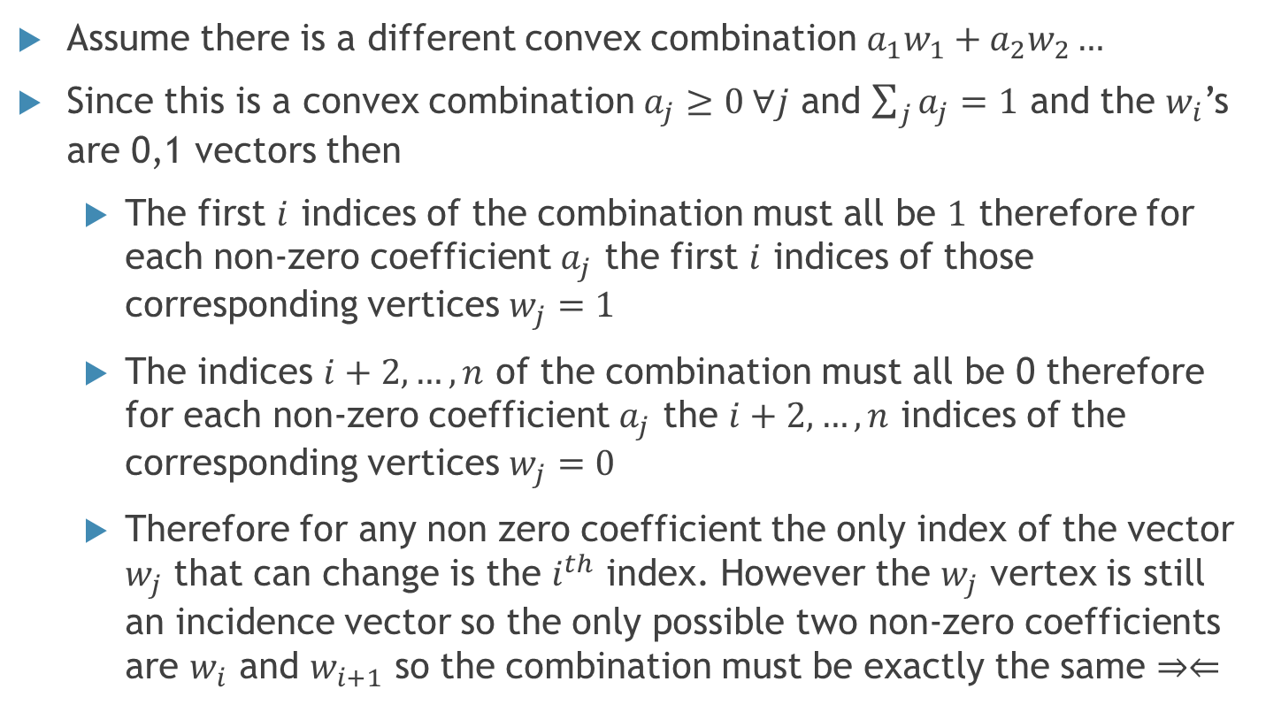
Show there are no other Convex combinations
Assume there is a different convex combination $a_{1}w_{1}+a_{2}w_{2}…$
Since this is a convex combination $a_{j}≥0 ∀j$ and $\sum_{j}{a_{j}}=1$ and the $w_{i}$’s are 0,1 vectors then
The first $i$ indices of the combination must all be $1$ therefore for each non-zero coefficient $a_{j}$ the first $i$ indices of those corresponding vertices $w_{j}=1$
The indices $i+2,…,n$ of the combination must all be 0 therefore for each non-zero coefficient $a_{j}$ the $i+2,…,n$ indices of the corresponding vertices $w_{j}=0$
Therefore for any non zero coefficient the only index of the vector $w_{j}$ that can change is the $i^{th}$ index. However the $w_{j}$ vertex is still an incidence vector so the only possible two non-zero coefficients are $w_{i}$ and $w_{i+1}$ so the combination must be exactly the same $⇒⇐$

Slide 8
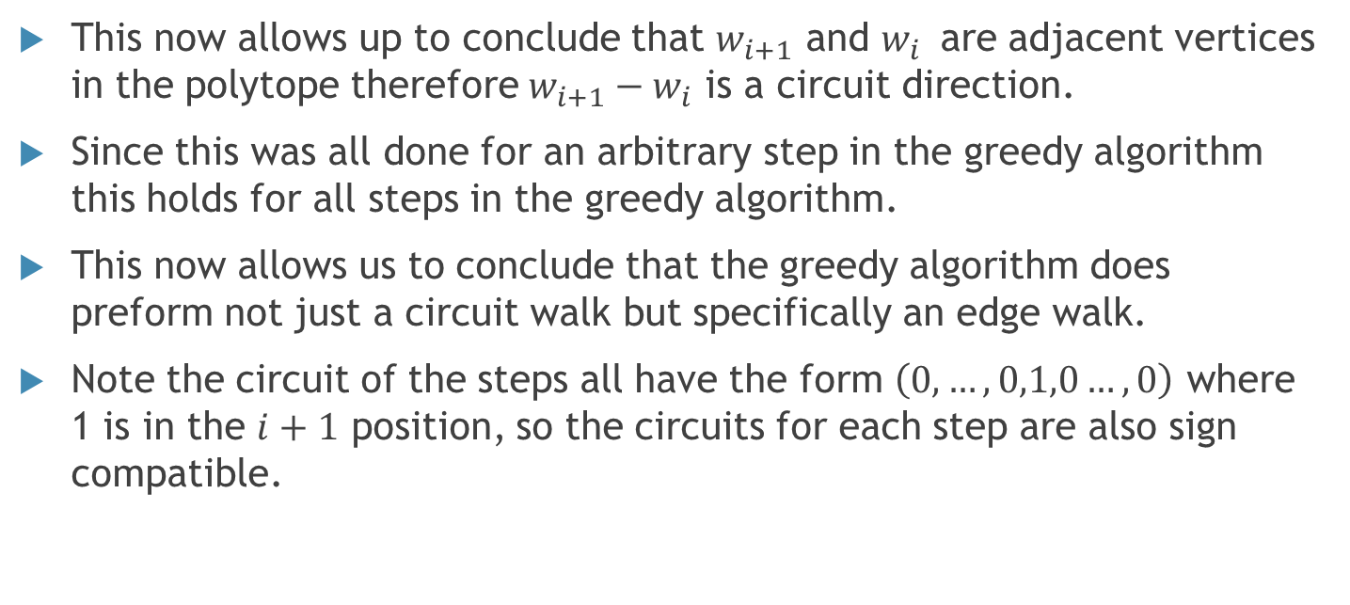
Greedy Algorithm Conclusion
This now allows up to conclude that $w_{i+1}$ and $w_{i }$ are adjacent vertices in the polytope therefore $w_{i+1}−w_{i}$ is a circuit direction.
Since this was all done for an arbitrary step in the greedy algorithm this holds for all steps in the greedy algorithm.
This now allows us to conclude that the greedy algorithm does preform not just a circuit walk but specifically an edge walk.
Note the circuit of the steps all have the form $\left(0,…,0,1,0…,0\right)$ where 1 is in the $i+1$ position, so the circuits for each step are also sign compatible.

Slide 9
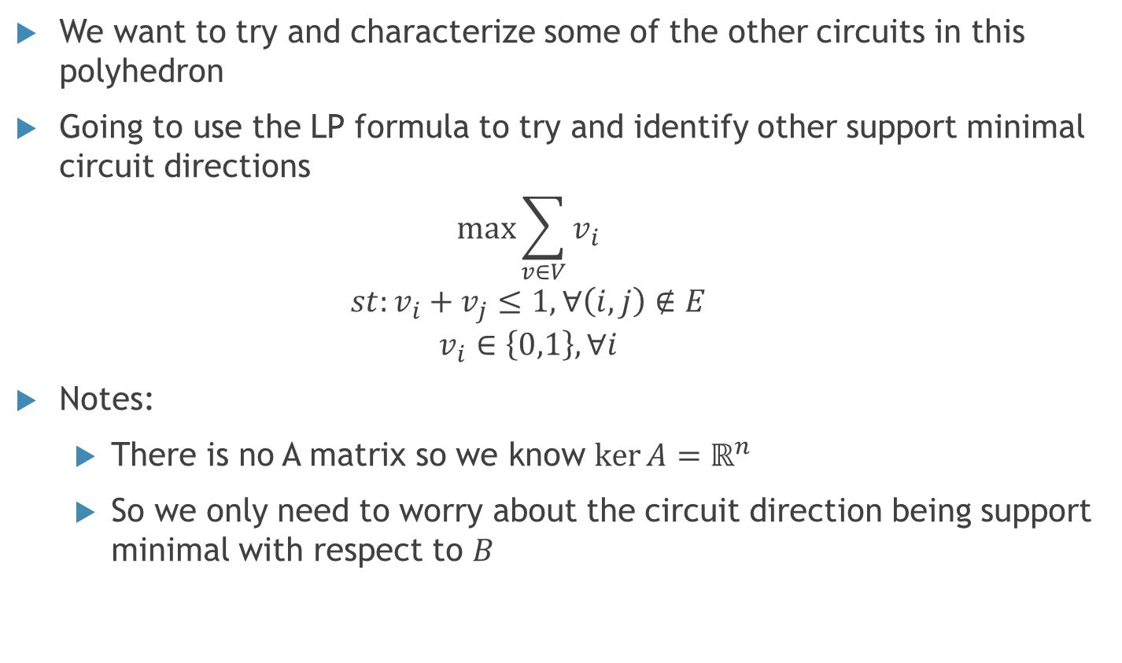
Trying to Characterize Other Circuits
We want to try and characterize some of the other circuits in this polyhedron
Going to use the LP formula to try and identify other support minimal circuit directions
$$\max{\sum_{v∈V}{v_{i}}}$$
$$st:v_{i}+v_{j}≤1, ∀\left(i,j\right)∉E$$
$$v_{i}∈\left\{0,1\right\}, ∀i$$
Notes:
There is no A matrix so we know $\ker{A}=ℝ^{n}$
So we only need to worry about the circuit direction being support minimal with respect to $B$

Slide 10
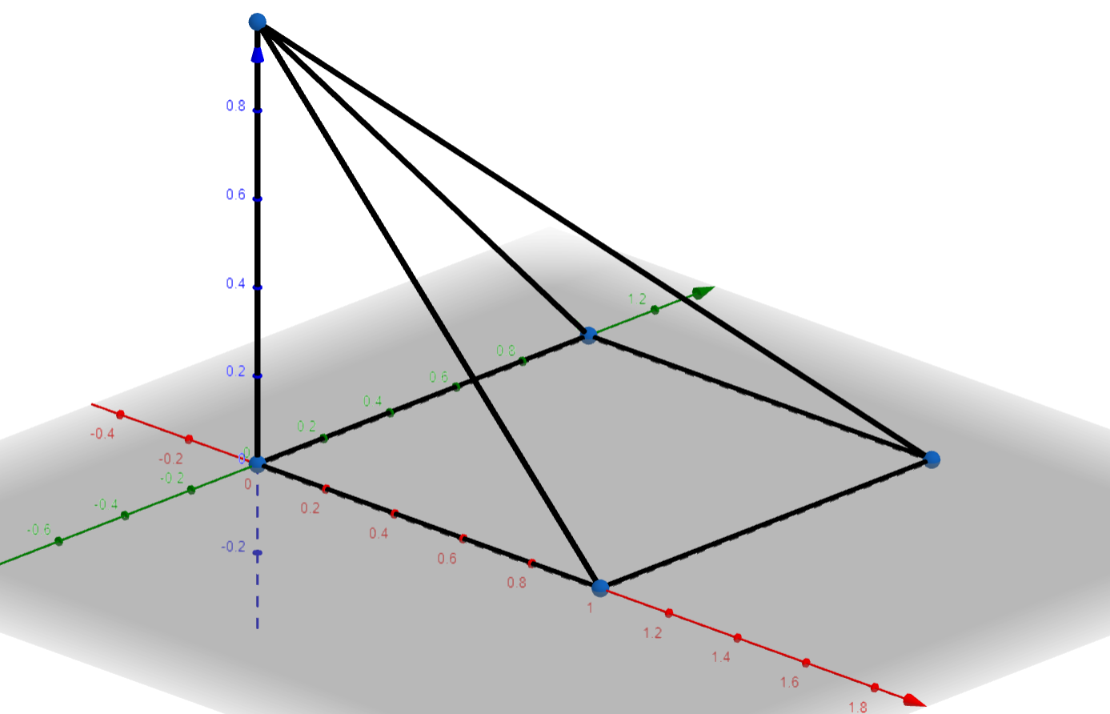


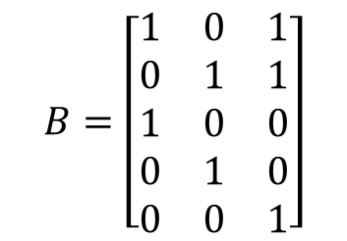

Justification Of Other Circuits Existing
Underlying Graph:
Polytope:
$$v_{3}$$
$$v_{1}$$
$$v_{2}$$
$$B=\left[\begin{matrix}1 & 0 & 1 \\ 0 & 1 & 1 \\ 1 & 0 & 0 \\ 0 & 1 & 0 \\ 0 & 0 & 1\end{matrix}\right]$$
Circuit Directions: $±\left\{\left(1,0,0\right),\left(0,1,0\right), \left(0,0,1\right),\left(1,−1,0\right),\left(0,1,−1\right),\left(1,1,−1\right)\right\}$

Slide 11

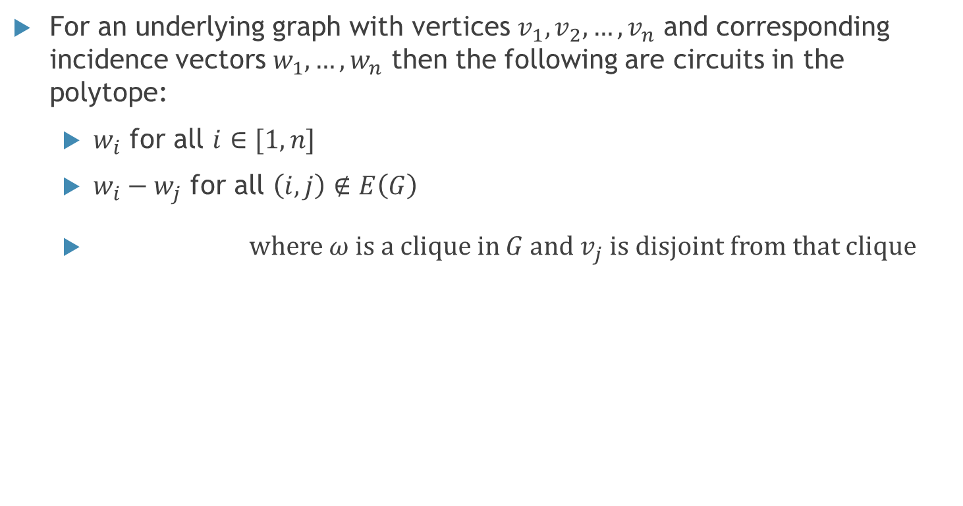
Working Hypothesis
For an underlying graph with vertices $v_{1},v_{2},…,v_{n}$ and corresponding incidence vectors $w_{1},…,w_{n}$ then the following are circuits in the polytope:
$w_{i}$ for all $i∈[1,n]$
$w_{i}−w_{j}$ for all $\left(i,j\right)∉E\left(G\right)$
where $ω$ is a clique in $G$ and $v_{j}$ is disjoint from that clique
$$\left(\sum_{i∈ω}{w_{i}}\right)−w_{j}$$

Slide 12
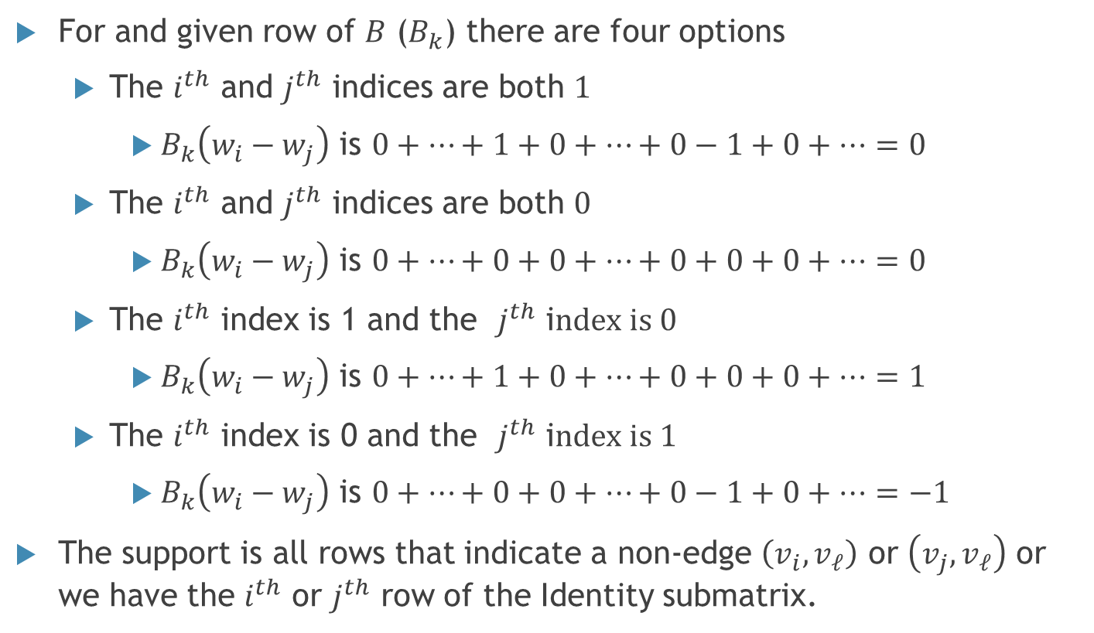

Find support of $w_{i}−w_{j}$
For and given row of $B$ ($B_{k}$) there are four options
The $i^{th}$ and $j^{th}$ indices are both $1$
$B_{k}\left(w_{i}−w_{j}\right)$ is $0+…+1+0+…+0−1+0+…=0$
The $i^{th}$ and $j^{th}$ indices are both $0$
$B_{k}\left(w_{i}−w_{j}\right)$ is $0+…+0+0+…+0+0+0+…=0$
The $i^{th}$ index is 1 and the $j^{th}$ i$ndex is 0$
$B_{k}\left(w_{i}−w_{j}\right)$ is $0+…+1+0+…+0+0+0+…=1$
The $i^{th}$ index is 0 and the $j^{th}$ i$ndex is 1$
$B_{k}\left(w_{i}−w_{j}\right)$ is $0+…+0+0+…+0−1+0+…=−1$
The support is all rows that indicate a non-edge $\left(v_{i},v_{ℓ}\right)$ or $\left(v_{j},v_{ℓ}\right)$ or we have the $i^{th}$ or $j^{th}$ row of the Identity submatrix.

Slide 13
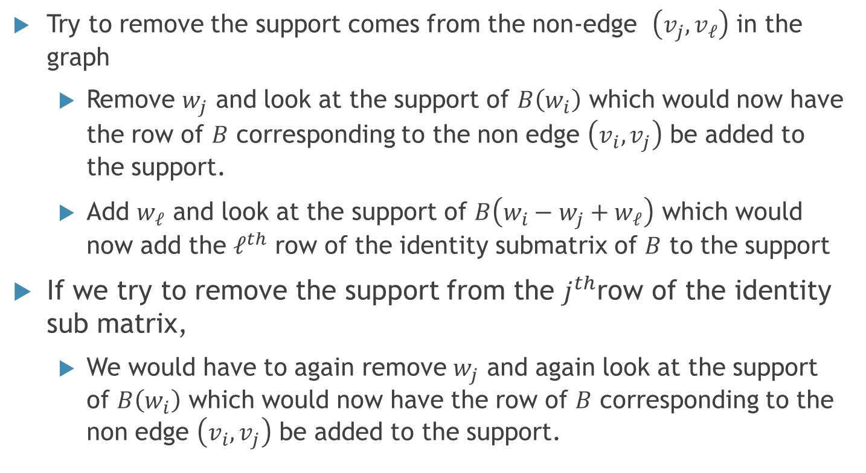
Showing that the support is inclusion minimal
Try to remove the support comes from the non-edge $\left(v_{j},v_{ℓ}\right)$ in the graph
Remove $w_{j}$ and look at the support of $B\left(w_{i}\right)$ which would now have the row of $B$ corresponding to the non edge $\left(v_{i},v_{j}\right)$ be added to the support.
Add $w_{ℓ}$ and look at the support of $B\left(w_{i}−w_{j}+w_{ℓ}\right)$ which would now add the $ℓ^{th}$ row of the identity submatrix of $B$ to the support
If we try to remove the support from the $j^{th}$row of the identity sub matrix,
We would have to again remove $w_{j}$ and again look at the support of $B\left(w_{i}\right)$ which would now have the row of $B$ corresponding to the non edge $\left(v_{i},v_{j}\right)$ be added to the support.

Slide 14
References
Korte, Bernhard, and Jens Vygen. Combinatorial Optimization: Theory and Algorithms. Springer, 2018.
De Simone, Caterina, and Mosca, Raffaele. Stable set and clique polytopes of (P5,gem)-free graphs. Discrete Mathematics, Volume 307, Issue 22,2007,Pages 2661-2670,ISSN 0012-365X, https://doi.org/10.1016/j.disc.2007.01.010.

